Slide 1
A simple chat server
By
Jan-Patrick Kirchner 742143
Konstantinos Karagkiozis 752753
Felix Hennig 752734

Slide 2
Outline
Component Diagram
Sequence Diagrams
Login
Text Message
File Message
Design
Live Demo

Slide 3
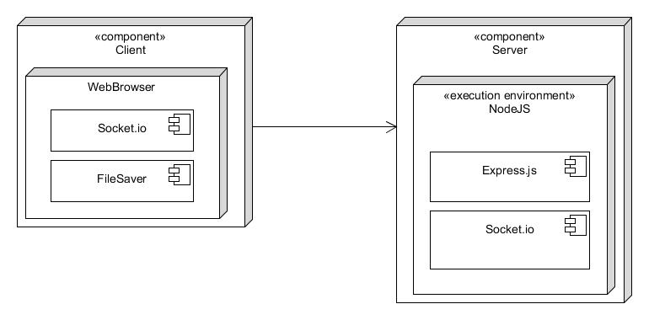
Component Diagram

Slide 4
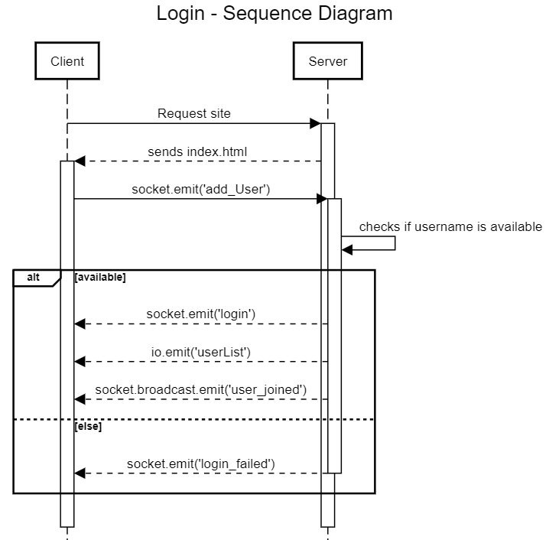
Sequence Diagram – Login

Slide 5
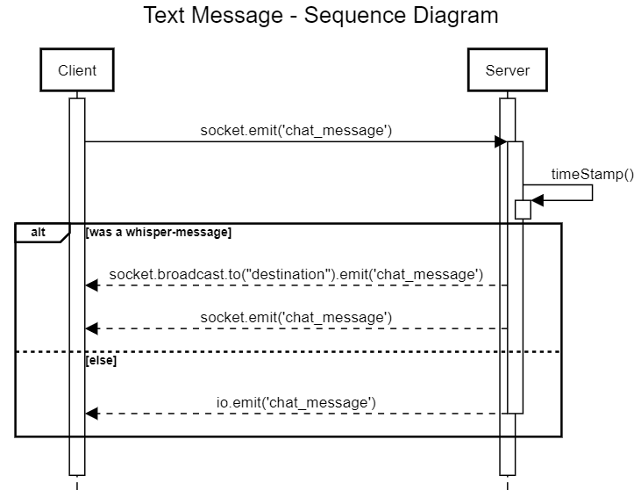
Sequence Diagram – Text Message

Slide 6
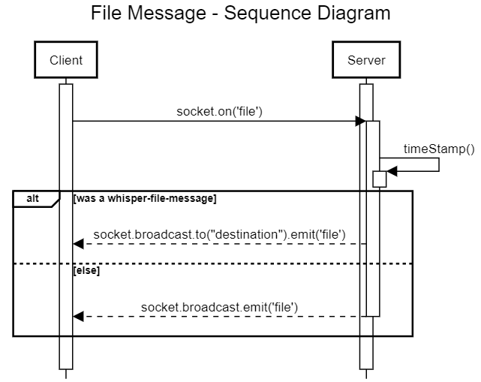
Sequence Diagram – File Message

Slide 7
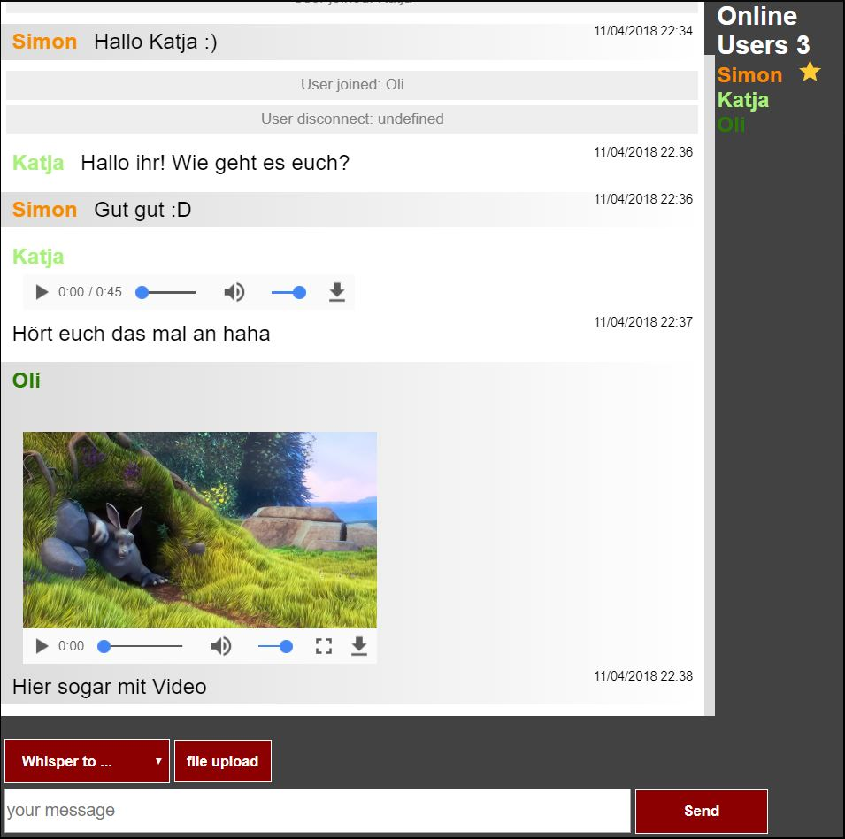
Design

Slide 8
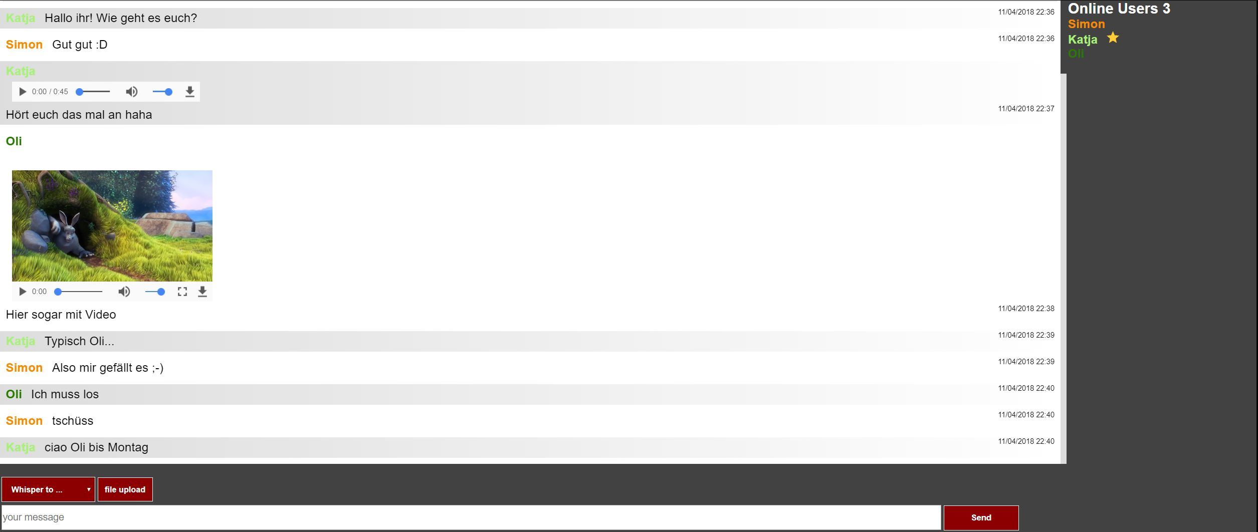
Design

Slide 9
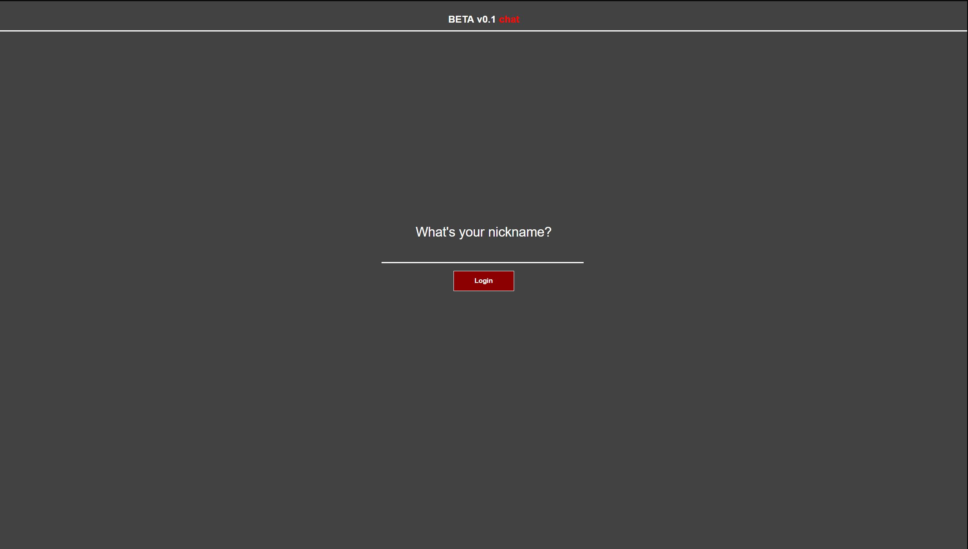
Live Demo

Slide 10
Thank you for your attention

